Slide 1

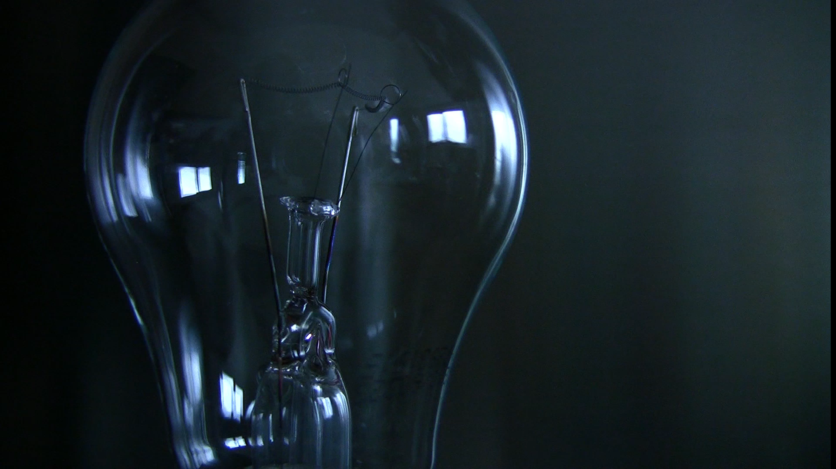
Study Session: Python for Basic Human Activity Recognition
Le Nhat Tan, M2
Sozolab

Slide 2
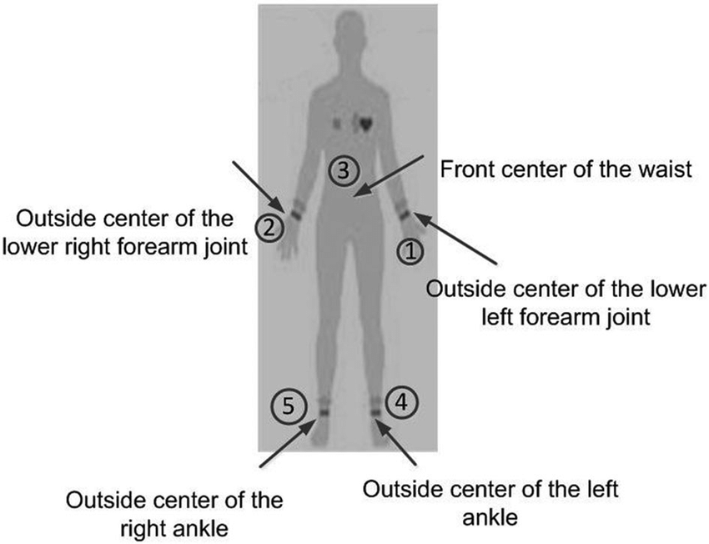


What is Human Activity Recognition (HAR)
Data from On-body inertial sensors/ camera
Collect, Process, Analysis
Human Activity, Behavior

Slide 3
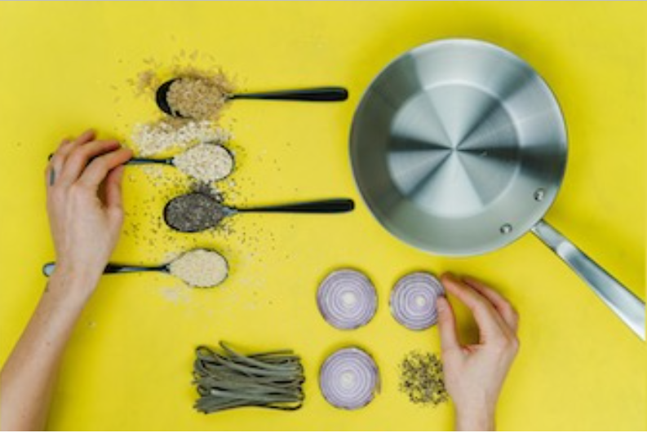

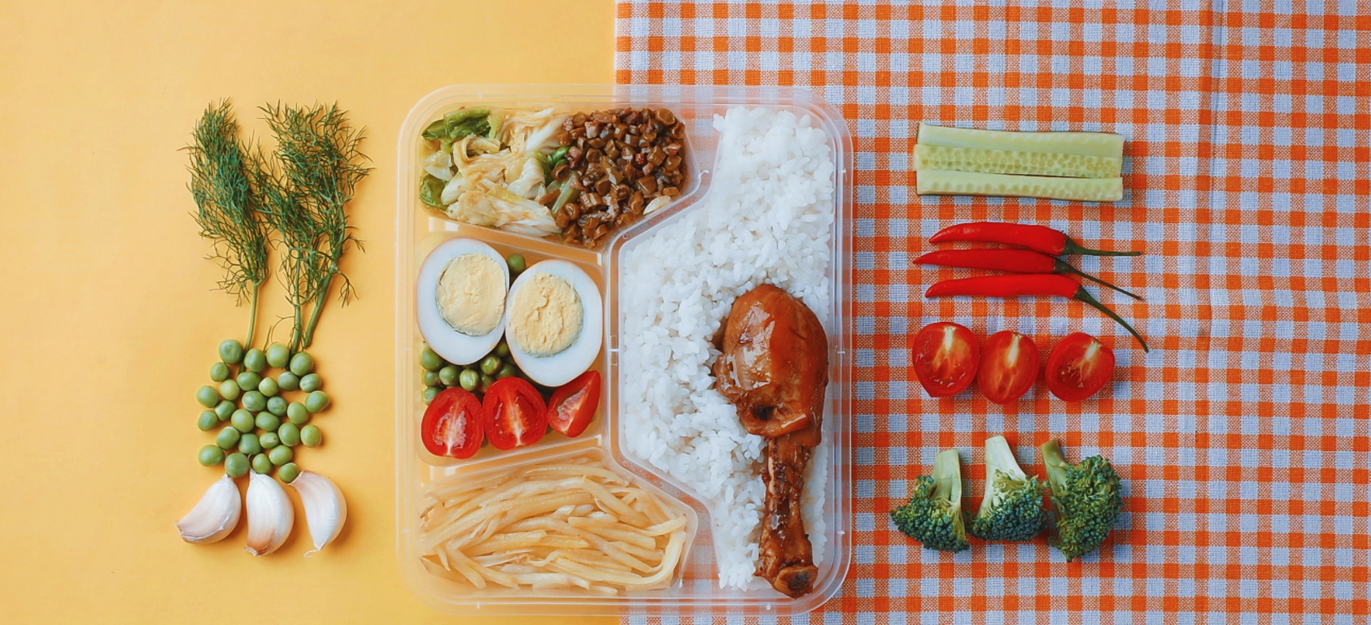
HAR Application
Nurse Care Activity Recognition
Cooking Activity Recognition
Bento box Activity Recognition

Slide 4
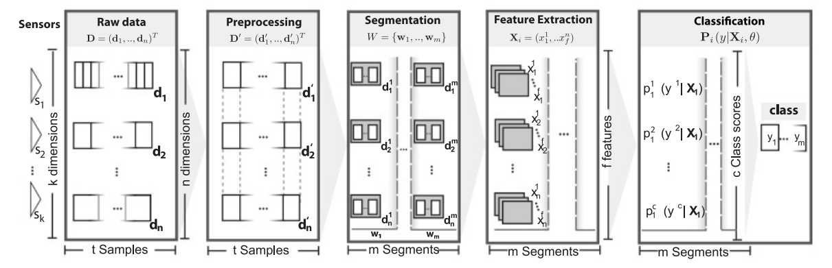
Basic HAR Process
Data Collection
Data Pre-processing
Segmentation
Feature Extraction
Classification
[1] Bulling et al, "A Tutorial on Human Activity Recognition Using Body-Worn Inertial Sensors"

Slide 5
Data Preprocessing
The raw time-series data could have missing data points. Handle the missing data:
Remove missing points.
Fill up by interpolation.
…
Data normalization.
Python library: pandas, numpy, …

Slide 6
Segmentation
Sliding Window: Segment the data by defining the window size, a fixed-size sliding window is commonly used.
Energy-based: differences in signal intensity directly translate to different energy levels, segment by energy thresholding.
…
Python library: pandas, numpy, …

Slide 7
Feature Extraction
Translate signals into features.
Statistical domain: mean, max, standard deviation, …
Temporal domain: entropy, slope, …
Spectral domain: FFT, Wavelet, …
…
Python library: pandas, numpy, TSFEL, …

Slide 8
Classification
Machine Learning: Decision Tree, kNN, SVM, …
Ensemble Learning: Random Forest, Bagging, …
Deep Learning: ANN, RNN, LSTM, …
Python library: scikit-learn, tensorflow, PyTorch, …

Slide 9
Evaluation
Intra-person & Inter-person.
K-fold Cross Validation & leave-one-person Cross Validation.
Metrics: F1-score, Accuracy, AUC, …
Confusion matrix

